Slide 1
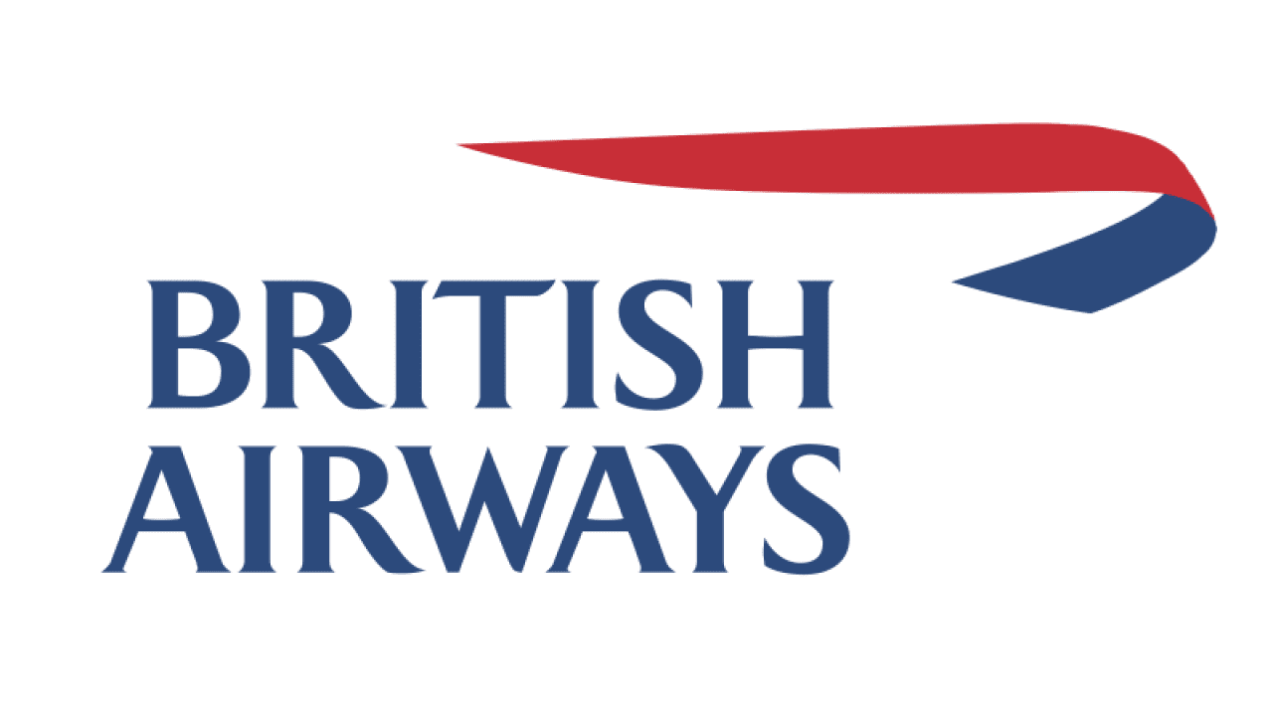
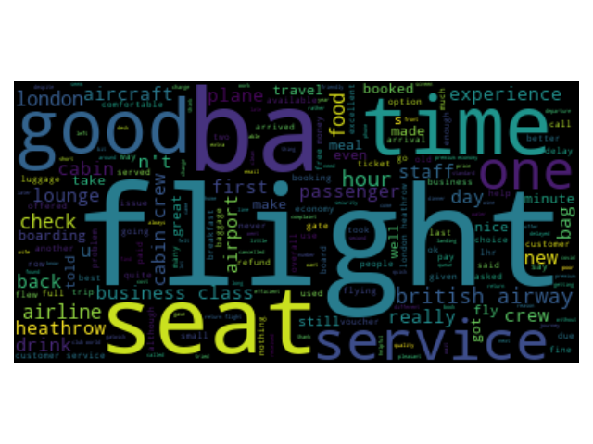
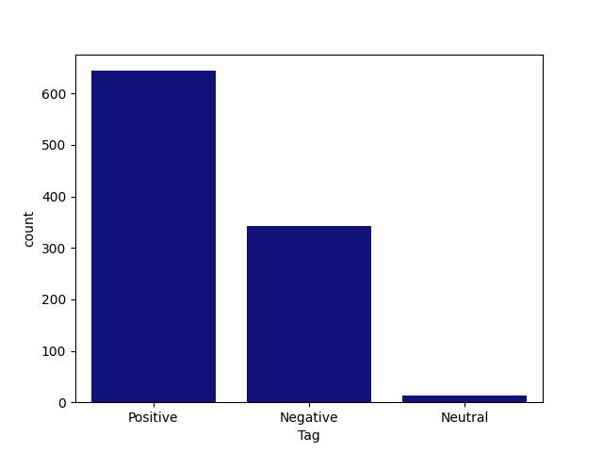
BRITISH AIRWAYS CUSTOMER FEEDBACK ANALYSIS
The Wordcloud image shows that the key topics within the reviews include “flight”, “seat”, “time”, “good” showing that people are actively talking about their experience and staff
Out of 1000 reviews that was scraped, 644 were positive, 342 were negative and 14 were neutral. This means majority of customers gave a positive review.

